Slide 1
X10 Workshop – Brief introduction to X10
Vijay Saraswat
IBM Confidential

Slide 2
X10: An Evolution of Java for the Scale-Out Era
X10 is an evolution of Java for concurrency and heterogeneity
  Language focuses on high productivity and high performance
  Leverages 5+ years of R&D funded by DARPA/HPCS
  The language provides
    Ability to specify fine-grained concurrency
    Ability to distribute computation across large-scale clusters
    Ability to represent heterogeneity at language level
    Single programming model for computation offload
    Modern OO language features (build libraries/frameworks)
    Interoperability with Java
X10: Performance and Productivity at Scale
Main Memory performance
At scale
Java-like productivity

Slide 3
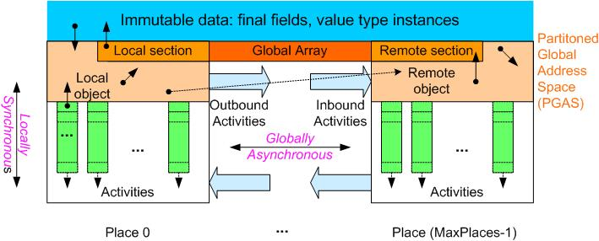
X10 and the APGAS model
  Class-based single-inheritance OO
  Structs
  Closures
  True Generic types (no erasures)
  Constrained Types (OOPSLA 08)
  Type inference
  User-defined operations
  Structured concurrency
class HelloWholeWorld {
public static def main(s:Array[String]):void {
finish
for (p in Place.places())
async
at (p)
Console.OUT.println("(At " + p + ") "
+ s(0));
}
}
Asychrony
async S
Atomicity
atomic S
when (c) S
Global data-structures
points, regions, distributions, arrays
Basic model is now well established
  PGAS is the only viable alternative to “share-nothing” scale-out (e.g. MPI).
  Asynchrony is very natural for modern networks.
Locality
at (P) S
Order
finish S
clocks
Java-like productivity, MPI-like performance
Notes:
How is the data to be operated on? Traditional PGAS languages like UPC and CAF specify that there is a single thread per place, and that all threads must operate in SPMD fashion.
This is limiting and does not support heterogenous accelerators very well. Instead we propose to make concurrency explicit and programmable by introducing the notion of an activity.
A place may have one or more activities operating on the data. Multiple activities in the same place may execute in parallel, provided the place is mapped onto multiple cores. Related control constructs, such as “finish” support a fork/join style of parallelism (a la OpenMP and Cilk). An activity may spawn another activity in a remote place --- this provides the basis for DMAs and messaging (a la MPI). One place may be mapped onto a single core (e.g. an Opteron core), whereas another place may be mapped onto multiple execution threads (e.g. a GPGPU).

Slide 4
Direction B: Write straight X10 code for irregular computations
while (true) {
val rr=right;
if (size <= PP)
return onePlaceSelect(rr, size, I);
finish for (p in 0..(P-1)) async
B(p) = at (Place(p)) worker().median(rr);
Utils.qsort(B);
val medianMedian=B((P-1)/2);
val sumT = finish (plus) {
for (p in 0..(P-1)) async at(Place(p)) {
val me = worker();
me.lastMedian=me.find(medianMedian);;
val k = me.lastMedian-me.low+1;
offer k;}};};
right = sumT < I+1;
if (!right && sumT==size)
return onePlaceSelect(right, size, I);
size = right ? size-sumT : sumT;
I = right ? I-sumT : I;
}
Selection problem (key statistic)
  Given a global array of N elements (say 10s of millions), find the I’th element
Naïve algorithm:
  Sort globally, select I’th element.
Better algorithm (Bader and Ja’ Ja’) – use parallel median of medians computation.
  Sort locally.
  Find median of medians
  Sum number of elements below medianMedian at each place
  Iterate until done.
Needs:
  Repeated, efficient multi-place communication
  Dynamic load-balancing (not shown)
No good algorithm known for Hadoop Map Reduce
X10

Slide 5
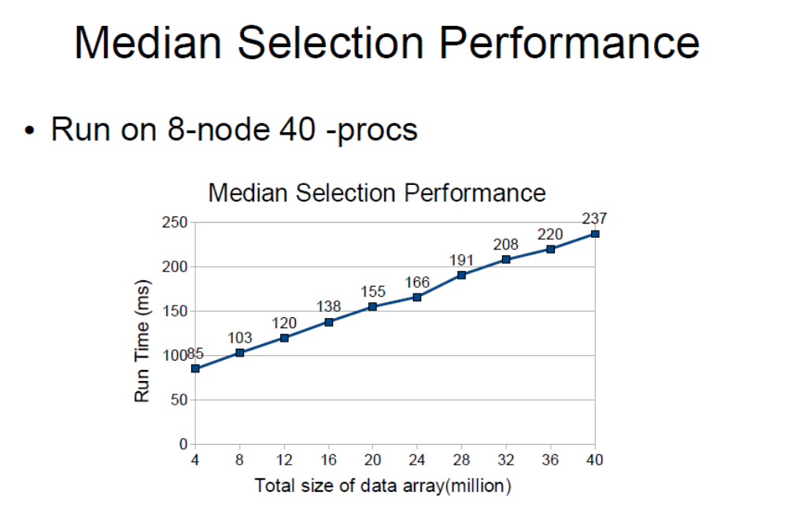
Median Selection
Numbers for native execution, using MPI.

Slide 6
X10 Target Environments
High-end large clustered systems (BlueGene, P7IH)
  BlueGene: [PPoPP 2011]: UTS 87% efficiency at 2k nodes
  P7IH: PERCS MS10a numbers next slide
  Goal: deliver scalable performance competitive with C+MPI
Medium-scale commodity systems
  ~100 nodes (~1000 cores and ~1 terabyte main memory)
  Scale out environments, but MTBF is days, not minutes
  Programs that run in minutes/hours at this scale
  Goal: deliver main-memory performance with simple programming model (accessible to Java programmers)
Developer laptops
  Linux, Mac, Windows. Eclipse-based IDE, debugger, etc.

Slide 7
X10 Compilation Flow
X10 Compiler Front-End
X10
Source
Parsing /
Type Check
X10 AST
AST Optimizations
AST Lowering
X10 AST
C++
Back-End
Java
Back-End
C++ Code
Generation
Java Code
Generation
C++ Source
Java Source
XRC
C++ Compiler
XRX
Java Compiler
XRJ
Native Code
Bytecode
Native X10
JNI
Managed X10
Native Env
X10RT
Java VMs
X10 compilation flow

Slide 8
X10 Current Status
X10 2.2.0 released
  First “forwards compatible” release
    Language specification stabilized; all changes will be backwards compatible
  Not product quality, but significantly more robust than any previous release
    Major focus on testing and defect reduction (>50% reduction in open defects)
X10 Implementations
  C++ based
    Multi-process (one place per process; multi-node)
    Linux, AIX, MacOS, Cygwin, BlueGene/P
    x86, x86_64, PowerPC
  JVM based
    Multi-process (one place per JVM process; multi-node)
      Windows single process only
    Runs on any Java 5/Java 6 JVM
X10DT (X10 IDE) available for Windows, Linux, Mac OS X
  Based on Eclipse 3.6
  Supports many core development task, including remote-execution facilities

Slide 9
X10 2.2 changes
Many bugs fixed
  462 JIRAs resolved for X10 2.2.0.
  Overall, about 330 open, 2415 have been closed.
Covariant and contra-variant type parameters are gone.
  May introduce existential types in a future release
Operator in is gone (cannot be redefined). in is a keyword.
Method functions, operator functions removed – use closures.
M..N now creates an IntRange, not a Region.
  More efficient code for for (I in m..n)…
Vars can no longer be assigned in their place of origin via an at. Use a GlobalRef[Cell[T]] instead.
  New syntax (athome) coming in 2.3 to represent this idiom more concisely.
next and resume keywords gone, replaced by static methods on Clock.

Slide 10
X10 2.2 Limitations
Non-static type definitions not implemented.
Non-final generic methods not implemented in C++ backend.
GC not enabled on AIX.
Exception stack trace not enabled on Cygwin.
Only single-place execution supported on Cygwin.
X10 runtime uses a busy wait loop – CPU cycles consumed even if there are no asyncs.
  To be fixed. See XTENLANG-1012.
List of Jiras fixed
http://jira.codehaus.org/browse/XTENLANG/fixforversion/16002

Slide 11
Major Technical Efforts
Cilk-style work-stealing (in progress)
Global load-balancing (PPoPP 2011)
X10 to CUDA compiler (paper at the X10 Workshop at PLDI 11)
Enabling multi-mode execution
  Mix Managed, Native, and Accelerator places in single computation
  Unified serialization protocol, runtime system enhancements, launcher, X10DT support, …
PERCS
  Scalability of runtime system to full PERCS system
  PAMI exploitation
Exploiting X10 to build (a) application frameworks, (b) distributed data structures, and (c) DSL runtimes

Slide 12
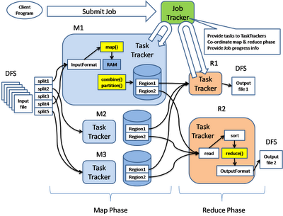
(a) Application Frameworks
JVMs launched for each mapper and reducer
  More recently, some provision for multi-threaded mappers.
All communication through the file system.
  Submitter to job tracker (splits)
  Mapper ➔ Reducer
  Input to reducer sorted externally.
All iterations independent of each other
  Data reloaded on each cycle from disk/buffers
  Computation may be moved to different nodes between cycles.
Big problem for iterative, compute-intensive problems of modest size (~1TB, running on ~20 nodes) for which answers are desired quickly, e.g. in interactive data analysis settings
E.g. one iteration of GNNMF with 2B non-zeros takes 2000 s on 40 cores (DML numbers a year old, currently improving)
Desired: “Quick” response for 50B non-zeros: say 15m/iteration instead of ~17 hrs
Ricky Ho’s blog
Design for reliable execution at scale on commodity clusters
  ~ 4000 nodes (Arun Murthy)
  Optimize for throughput not latency.
  Support re-execution, and recovery from node or disk failure
  ➔ Unstructured log analysis, document conversion,
Notes:
Calculations: DML paper reports about 750 s for 1B non-zero, then 1250s for every additional 1B non-zero, for 40 cores.
This translates to 62500 s ~ 17hrs.
Say: 20 8-core nodes, with 64GB RAM/node
Memory is

Slide 13
(b) Build Global Libraries
Sparse matrix vector product
Large matrices, distributed across multiple places.
Implemented X10 global matrix library for sparse/dense matrices.
  Uses BLAS for dense local multiply’s
  Uses fast SUMMA algorithm for global multiply
  Hides finish/async/at
  Programmer decides which kind of matrix to create and invokes operations on them
Direct representation of the mathematical definition of Page Rank.
while (I < max_iteration) {
p = alpha*(G%*%p)+(1-alpha)*(e%*%u%*%p);
}
DML
for (1..iteration) {
GP.mult(G,P)
.scale(alpha)
.copyInto(dupGP);//broadcast
P.local()
.mult(E, UP.mult(U,P.local()))
.scale(1-alpha)
.cellAdd(dupGP.local())
.sync(); // broadcast
}
X10

Slide 14
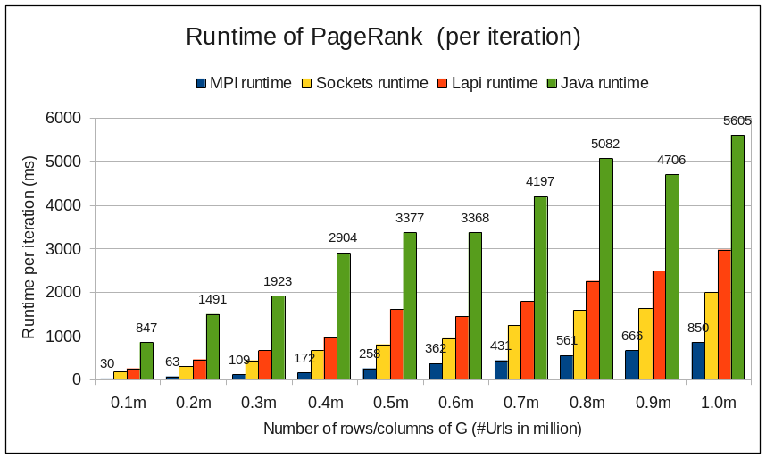
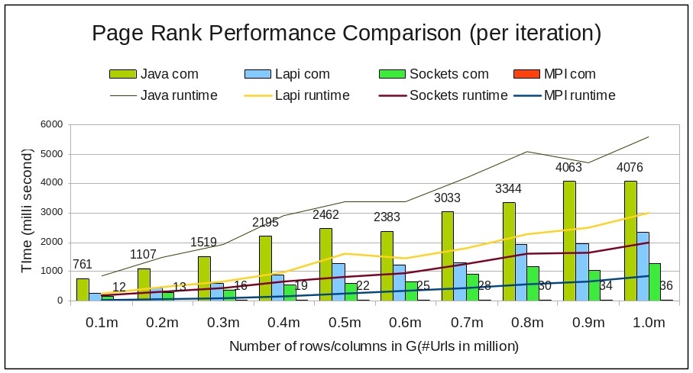
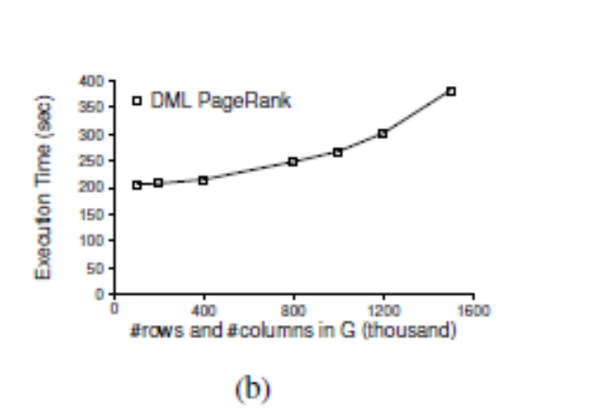
(b) PageRank performance
DML/Hadoop number is approximately 50 -100 URLs/core/sec. Note: slower network.

Slide 15
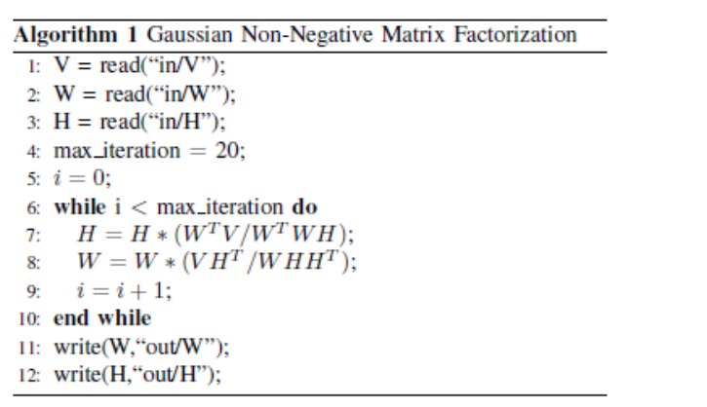
(b) Gaussian Non-Negative Matrix Multiplication
Key decision is representation for matrix, and its distribution.
  Note: app code is polymorphic in this choice.
Key kernel for topic modeling
Involves factoring a large (D x W) matrix
  D ~ 100M
  W ~ 100K, but sparse (0.001)
Iterative algorithm, involves distributed sparse matrix multiplication, cell-wise matrix operations.
V
W
H
P0
H
P1
H
P2
H
Pn
for (1..iteration) {
H.cellMult(WV
.transMult(W,V,tW)
.cellDiv(WWH
.mult(WW.transMult(W,W),H)));
W.cellMult(VH
.multTrans(V,H)
.cellDiv(WHH
.mult(W,HH.multTrans(H,H))));
}
X10

Slide 16
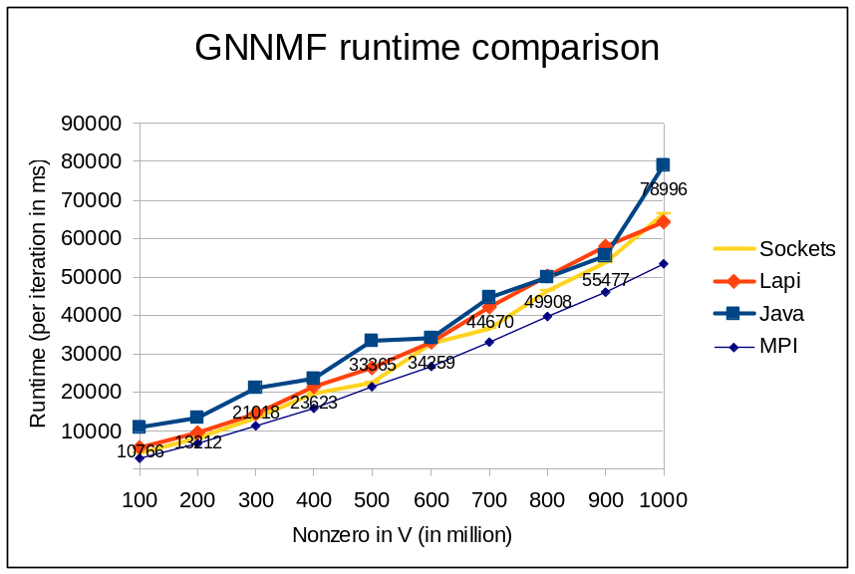
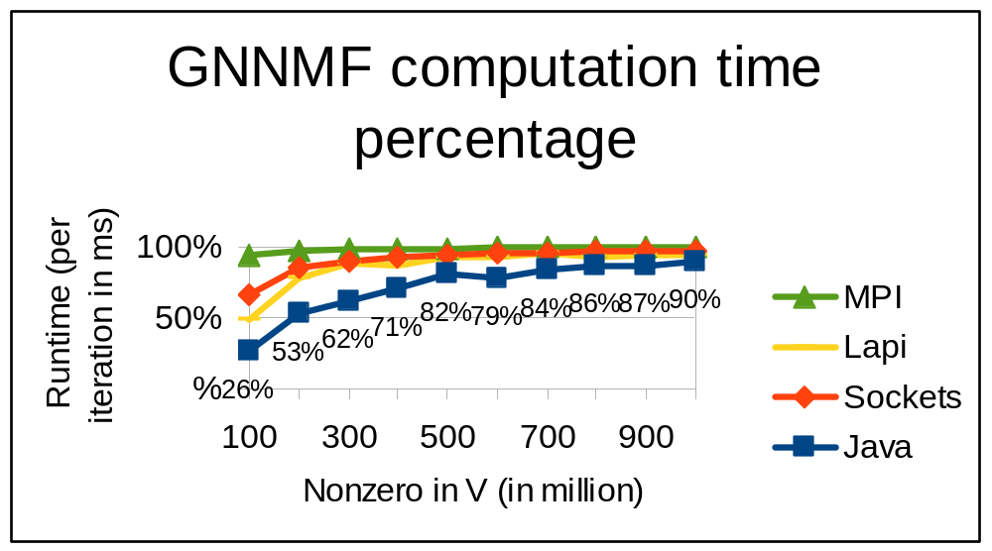
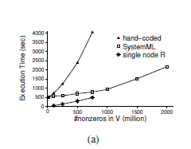
(b) GNNMF Performance
MPI numbers are about 2x slower than previously reported (but better space consumption)
8 nodes, 40 procs, native execution, Java
➔ About 10x better at 1B NZ.
DML/Hadoop code is still evolving. Note: slower network.

Slide 17
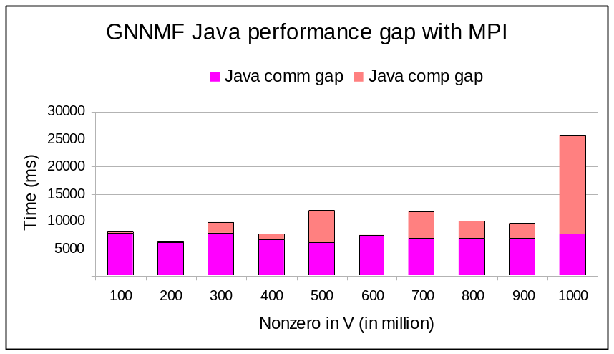
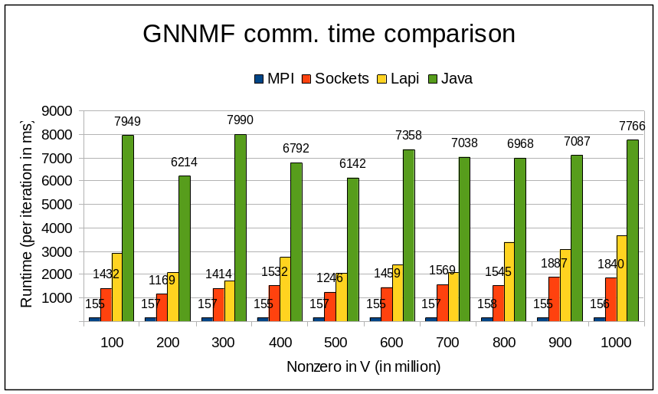
Performance gap with MPI

Slide 18
(c) Domain Specific Language Development
Use X10 to implement language runtimes for DSLs
  Leverage multi-place execution, X10 data structures, etc.
  Good match
    DSLs that are implicitly parallel, mostly declarative, operate over aggregate data structures (trees, matrices, graphs)
    User programs in sequential, global view
    Compiler/runtime handle distribution, concurrency, etc.
An initial proof-of-concept: DMLX
  Compiles DML programs to intermediate form interpreted in X10
    Soon, compile directly to X10
  Compiled X10 code leverages X10 Global Matrix Library to implement DML operations
  Ongoing implementation & performance analysis

